Slide 1


HUMAN RESOURCE
PLANNING AND RECRUITMENT

Slide 2






WHAT IS HUMAN RESOURCE PLANNING
Human resource planning is a process that helps companies identify the current and future HR needs they'll need to address to meet their strategic goals. It's a process by which the human resources requirements of a given company are clearly identified, and a plan is put in place to ensure that those needs are met.

Slide 3

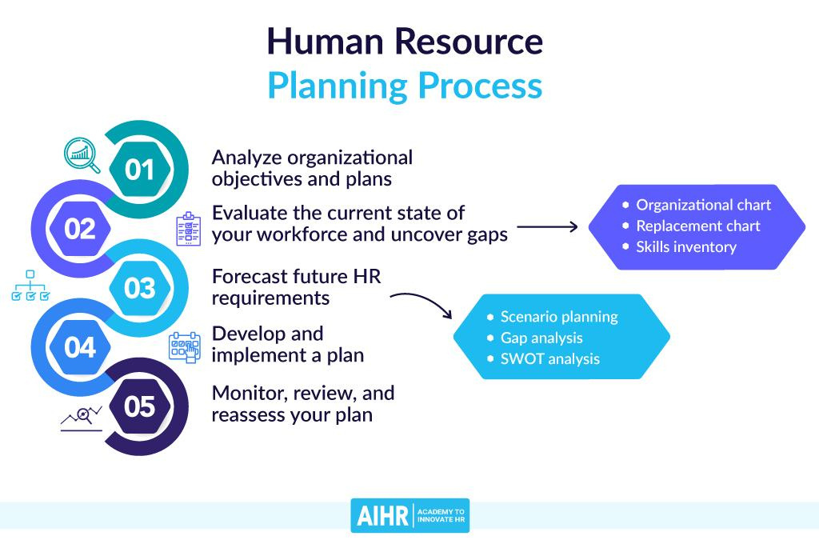



Slide 4

IMPORTANCE OF HUMAN RESOURCE PLANNING
Organizations must be able to adapt their human capital to sustain the continuous shifts in technology, local and global economics, product innovation, and culture. Human resource planning is integral to maximizing a well-equipped workforce, and it offers other advantages that assist in accomplishing your organization's mission.

Slide 5


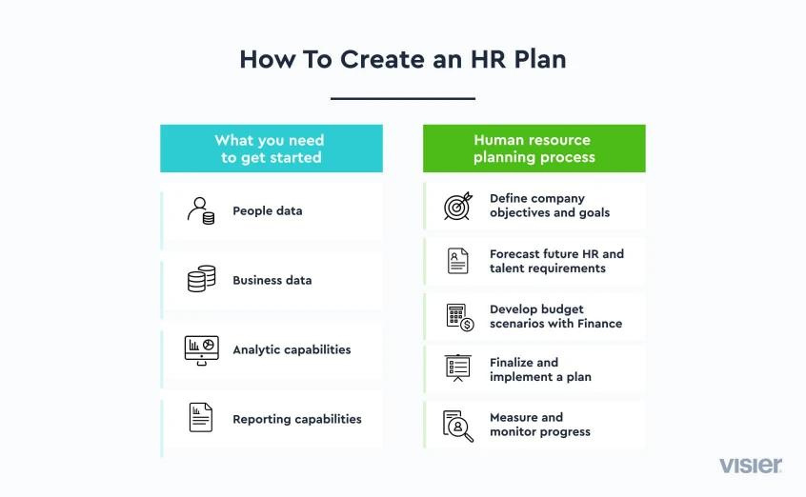
HOW TO CREATE AN HR PLAN

Slide 6

WHAT IS RECRUITMENT IN HUMAN RESOURCES
Recruitment is the process of finding and hiring the best-qualified candidate from within or outside of an organization for a job opening in a timely and cost- effective manner. The recruitment process includes analyzing the requirements of a job, attracting employees to that job, screening and selecting applicants, hiring, and integrating the new employee into the organization.

Slide 7

STAGE FOR RECRUITMENT
IN HUMAN RESOURCES
The recruitment process begins with an analysis of organizationalroles by the HR department. Once the scope of employees has been determined, job descriptions can be created to define the roles of new positions being added to the organization.
STAGE OF RECRUITMENT
PROCESS IN HUMAN RESOURCES
• Job analysis
•Advertising
•Screening of applicants
• Finalization

Slide 8

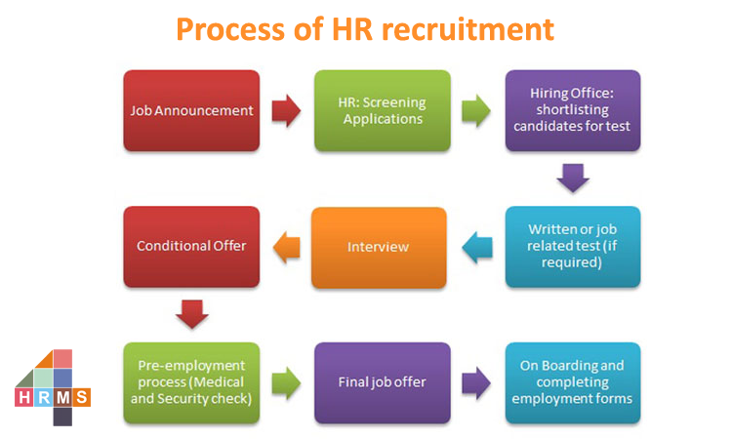
PROCESS OF HR RECRUITMENT

Slide 9


Thank You!!

